Slide 1
EQ2341
Pattern Recognition and Machine Learning
Assignment
5
Yuqi Zheng, Jingxuan Mao
May 26, 2022

Slide 2
1
Background
Inspiration: Application of speech recognition.
-Voice commands, voice search, voice-to-text…
Dataset: Speech Commands Datasets.
-TensorFlow Speech Recognition Challenge
Aim: To classify different speech records into single commands.
-yes, no, up, down, left, right, on, off, stop, go

Slide 3
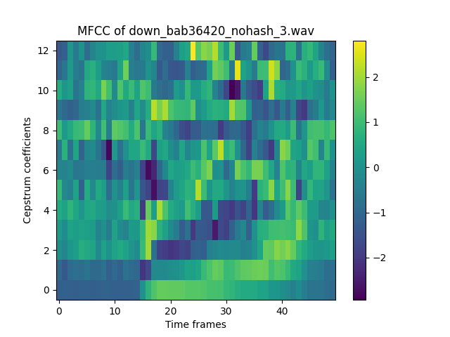
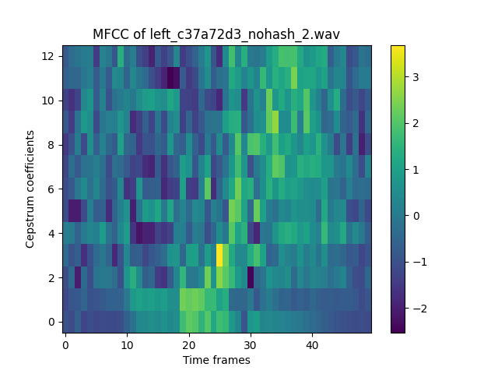
2
Feature Extraction
Features of speech: normalized MFCCs
Notes:
Discrete or continuous? Scalars or vectors?
Ways data can vary. (phoneme, pitch, speed, …
Techniques vs. variation. (mfccs normalization

Slide 4
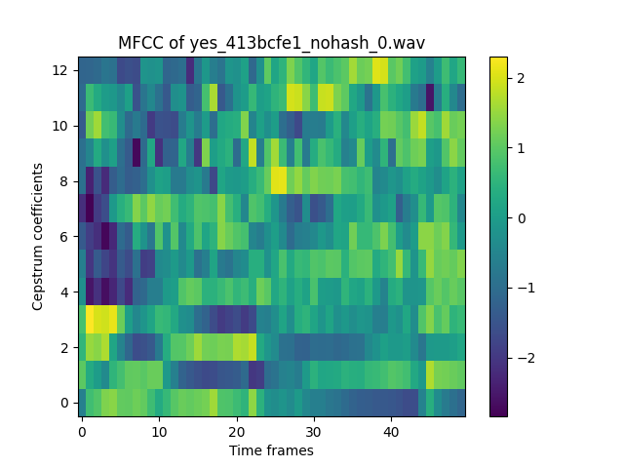
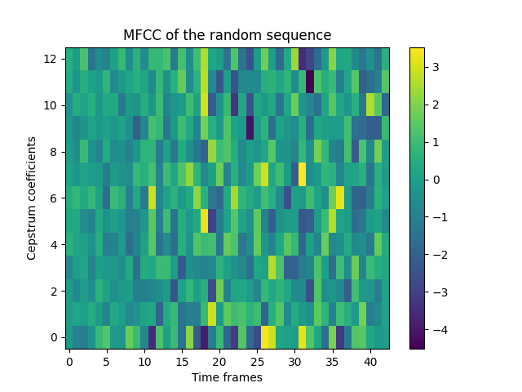
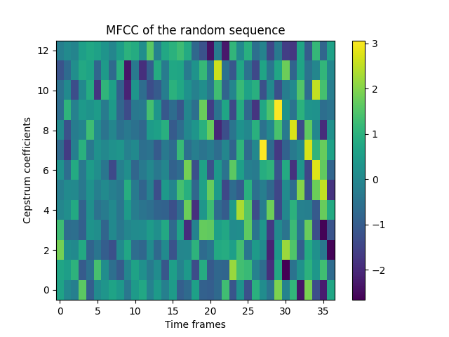
2
Feature Extraction
Training example VS. Random sequence
Notes:
Discrete or continuous? Scalars or vectors?
Ways data can vary. (phoneme, pitch, speed, …
Techniques vs. variation. (mfccs normalization

Slide 5
3
HMM Design
Word | Phonemes | # of States
Yes | Y EH S | 5
No | N OW | 4
Up | AH P | 4
Down | D AO N | 6
Left | L EH F T | 6
Right | R AY T | 5
On | AH N | 4
Off | AA F | 4
Stop | S T AA P | 6
Go | G OW | 4
States: silence, phoneme1, phoneme2, …, silence
Notes:
Phoneme + silence = state

Slide 6
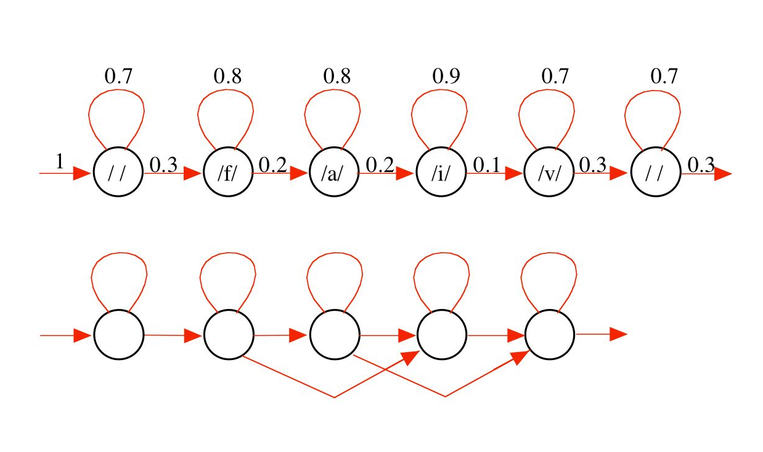
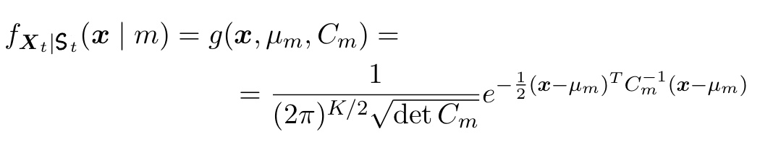

3
HMM Design
Left-right HMM
$$λ=\{q, A, C\}$$
Notes:
Phoneme + silence = state

Slide 7

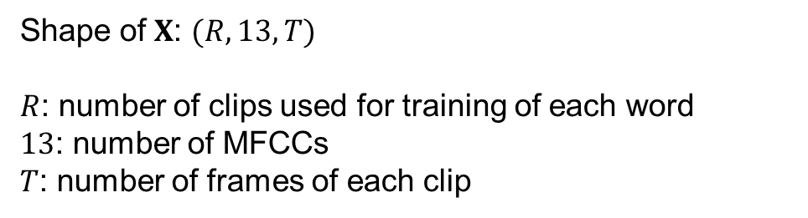
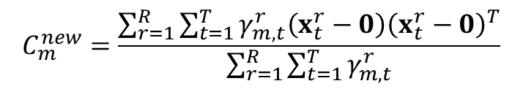
4
HMM Training
Baum-Welch Algorithm: Iteratively optimizing HMM.
$$\left\{\left\{q, A\right\}, C\right\}→q^{new}$$
$$\left\{\left\{q, A\right\}, C\right\}→A^{new}$$
$$\left\{\left\{q, A\right\}, C\right\}→C^{new}$$
$$\log{P\left(x|λ^{n}\right)>\log{P\left(x|λ^{n−1}\right)}}$$
$$C_{m}^{new}=\frac{\sum_{r=1}^{R}{\sum_{t=1}^{T}{γ_{m,t}^{r}\left(x_{t}^{r}−0\right){\left(x_{t}^{r}−0\right)}^{T}}}}{\sum_{r=1}^{R}{\sum_{t=1}^{T}{γ_{m,t}^{r}}}}$$
Shape of $X$: $(R, 13, T)$
$R$: number of clips used for training of each word
$13$: number of MFCCs
$T$: number of frames of each clip

Slide 8
4
HMM Training
Cross Validation: K-fold, K=2
 | Training Set | Testing Set
Fold 1 | First 40% | Last 30%
Fold 2 | Last 40% | First 30%

Slide 9



Begin
4
HMM Training
Initialize $λ$
@HMM/train Input:
MFCCs of all frames of all training clips
@HMM/train Output:
$A$, covariance of conditional state distributions
Preprocess and input training data
Calculate MFCCs
Update $λ$
End

Slide 10
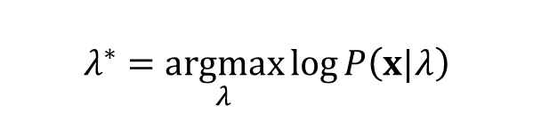



Begin
4
HMM Testing
Preprocess and input testing data
Calculate MFCCs
Calculate $P\left(x|S,λ_{i}\right)$
$$λ^{∗}=\underset{λ}{argmax}{\log{P\left(x|λ\right)}}$$
Forward Algorithm
Calculate $\log{P\left(x|λ_{i}\right)}$
Find $λ^{∗}$
End

Slide 11
4
HMM Testing
Confusion Matrix of Fold 1:
 | Down | Go | Left | No | Off | On | Right | Stop | Up | Yes
Down | 0.12018 | 0.13713 | 0.02773 | 0.21263 | 0.03544 | 0.17720 | 0.06780 | 0.01233 | 0.19260 | 0.01695
Go | 0.03180 | 0.51033 | 0.02226 | 0.17806 | 0.04134 | 0.05564 | 0.04134 | 0.00477 | 0.10811 | 0.00636
Left | 0.03072 | 0.09831 | 0.25038 | 0.11982 | 0.11214 | 0.02765 | 0.06605 | 0.03840 | 0.16743 | 0.08909
No | 0.04245 | 0.21698 | 0.00786 | 0.51415 | 0.01887 | 0.06761 | 0.02044 | 0.00314 | 0.09748 | 0.01101
Off | 0.00315 | 0.09464 | 0.00631 | 0.04101 | 0.58517 | 0.03943 | 0.00158 | 0.02050 | 0.19874 | 0.00946
On | 0.03035 | 0.07668 | 0.01278 | 0.14217 | 0.08147 | 0.42812 | 0.00479 | 0.00479 | 0.21246 | 0.00639
Right | 0.10046 | 0.10819 | 0.07419 | 0.12210 | 0.02782 | 0.03709 | 0.37249 | 0.02164 | 0.10046 | 0.03555
Stop | 0.00617 | 0.04475 | 0.03086 | 0.01698 | 0.35031 | 0.01080 | 0.00154 | 0.36728 | 0.13889 | 0.03241
Up | 0.01789 | 0.11382 | 0.01789 | 0.05854 | 0.10244 | 0.06341 | 0.00813 | 0.01789 | 0.58374 | 0.01626
Yes | 0.01095 | 0.00313 | 0.03443 | 0.02191 | 0.01408 | 0.00156 | 0.05321 | 0.00313 | 0.00626 | 0.85133

Slide 12
4
HMM Testing
Confusion Matrix of Fold 2:
 | Down | Go | Left | No | Off | On | Right | Stop | Up | Yes
Down | 0.08202 | 0.10568 | 0.05047 | 0.20347 | 0.04732 | 0.18297 | 0.07098 | 0.00473 | 0.24763 | 0.00473
Go | 0.00954 | 0.53418 | 0.02067 | 0.14944 | 0.07154 | 0.03498 | 0.00477 | 0.00636 | 0.15898 | 0.00954
Left | 0.03251 | 0.11765 | 0.26316 | 0.12539 | 0.12539 | 0.04180 | 0.05882 | 0.03560 | 0.15480 | 0.04489
No | 0.02408 | 0.24238 | 0.02087 | 0.44944 | 0.03531 | 0.10915 | 0.01124 | 0.01284 | 0.08989 | 0.00482
Off | 0.00630 | 0.05669 | 0.00787 | 0.03465 | 0.60157 | 0.08346 | 0.00157 | 0.01260 | 0.19213 | 0.00315
On | 0.02532 | 0.05222 | 0.01899 | 0.17722 | 0.07753 | 0.45728 | 0.00316 | 0.01424 | 0.16930 | 0.00475
Right | 0.04006 | 0.12330 | 0.11710 | 010632 | 0.03082 | 0.04468 | 0.34669 | 0.03390 | 0.10632 | 0.03082
Stop | 0.00000 | 0.01687 | 0.03221 | 0.00767 | 0.23313 | 0.01227 | 0.00153 | 0.53221 | 0.13190 | 0.03221
Up | 0.00962 | 0.07372 | 0.02885 | 0.04487 | 0.10577 | 0.06090 | 0.00000 | 0.02404 | 0.64744 | 0.00481
Yes | 0.00464 | 0.00774 | 0.07276 | 0.02322 | 0.00929 | 0.00310 | 0.03870 | 0.02012 | 0.00464 | 0.81579

Slide 13
4
HMM Testing
Confusion Matrix:
 | Down | Go | Left | No | Off | On | Right | Stop | Up | Yes
Down | 0.1011 | 0.121405 | 0.0391 | 0.20805 | 0.04138 | 0.180085 | 0.06939 | 0.00853 | 0.220115 | 0.01084
Go | 0.02067 | 0.522255 | 0.021465 | 0.16375 | 0.05644 | 0.04531 | 0.023055 | 0.005565 | 0.133545 | 0.00795
Left | 0.031615 | 0.10798 | 0.25677 | 0.122605 | 0.118765 | 0.034725 | 0.062435 | 0.037 | 0.161115 | 0.06699
No | 0.033265 | 0.22968 | 0.014365 | 0.481795 | 0.02709 | 0.08838 | 0.01584 | 0.00799 | 0.093685 | 0.007915
Off | 0.004725 | 0.075665 | 0.00709 | 0.03783 | 0.59337 | 0.061445 | 0.001575 | 0.01655 | 0.195435 | 0.006305
On | 0.027835 | 0.06445 | 0.015885 | 0.159695 | 0.0795 | 0.4427 | 0.003975 | 0.009515 | 0.19088 | 0.00557
Right | 0.07026 | 0.115745 | 0.095645 | 5316.061 | 0.02932 | 0.040885 | 0.35959 | 0.02777 | 0.10339 | 0.033185
Stop | 0.003085 | 0.03081 | 0.031535 | 0.012325 | 0.29172 | 0.011535 | 0.001535 | 0.449745 | 0.135395 | 0.03231
Up | 0.013755 | 0.09377 | 0.02337 | 0.051705 | 0.104105 | 0.062155 | 0.004065 | 0.020965 | 0.61559 | 0.010535
Yes | 0.007795 | 0.005435 | 0.053595 | 0.022565 | 0.011685 | 0.00233 | 0.045955 | 0.011625 | 0.00545 | 0.83356

Slide 14
4
HMM Testing
Correct Rate:
 | Down | Go | Left | No | Off | On | Right | Stop | Up | Yes | Avg
Mean | 0.1011 | 0.522255 | 0.25677 | 0.481795 | 0.59337 | 0.4427 | 0.35959 | 0.449745 | 0.61559 | 0.83356 | 0.465648
Var | 0.000728 | 0.000082 | 0.021465 | 0.002094 | 0.000134 | 0.000425 | 0.000333 | 0.013601 | 0.002029 | 0.000632 | 0.004152

Slide 15
4
HMM Testing
Correct Rate of 5-Fold Cross Validation, sorted dataset:
 | Down | Go | Left | No | Off | On | Right | Stop | Up | Yes | Avg
Mean | 0.2069825 | 0.0125 | 0.354271 | 0.806931 | 0.707379 | 0 | 0.231343 | 0.060386 | 0.298469 | 0.666667 | 0.334493
Var | 0.12709 | 0.00132 | 0.15004 | 0.00251 | 0.00333 | 0 | 0.09726 | 0.01217 | 0.08622 | 0.00569 | 0.048563
Correct Rate of 2-Fold Cross Validation, sorted dataset:
 | Down | Go | Left | No | Off | On | Right | Stop | Up | Yes | Avg
Mean | 0.16656 | 0.379562 | 0.310432 | 0.413033 | 0.420639 | 0.169419 | 0.541667 | 0.479167 | 0.478682 | 0.913793 | 0.427295
Var | 0.00321 | 0.13722 | 0.00152 | 0.14798 | 0.15726 | 0.02687 | 0.0434 | 0.02127 | 0.07361 | 0.00743 | 0.061978
Correct Rate of 2-Fold Cross Validation, unsorted dataset:
 | Down | Go | Left | No | Off | On | Right | Stop | Up | Yes | Avg
Mean | 0.1011 | 0.522255 | 0.25677 | 0.481795 | 0.59337 | 0.4427 | 0.35959 | 0.449745 | 0.61559 | 0.83356 | 0.465648
Var | 0.000728 | 0.000082 | 0.021465 | 0.002094 | 0.000134 | 0.000425 | 0.000333 | 0.013601 | 0.002029 | 0.000632 | 0.004152

Slide 16
5
Conclusions
HMM design: Try to avoid overfitting.
- enough training data, diverse data
Strengths: A simple model could achieve a relatively accurate classification;
training is not time consuming.
Weakness: Testing takes a long time;
easy to overfit;
hard to generalize.
- different speaker, different phonemes, different characteristics
What we have learned: Design HMM carefully (states, structure, algorithm, …);
appropriate training data

Slide 17
Thanks for listening!
Assignment
5

